Slide 1
TIES-MERGING: Resolving Interference When Merging Models
Tianwei Zhao, Ziyao Mou

Slide 2
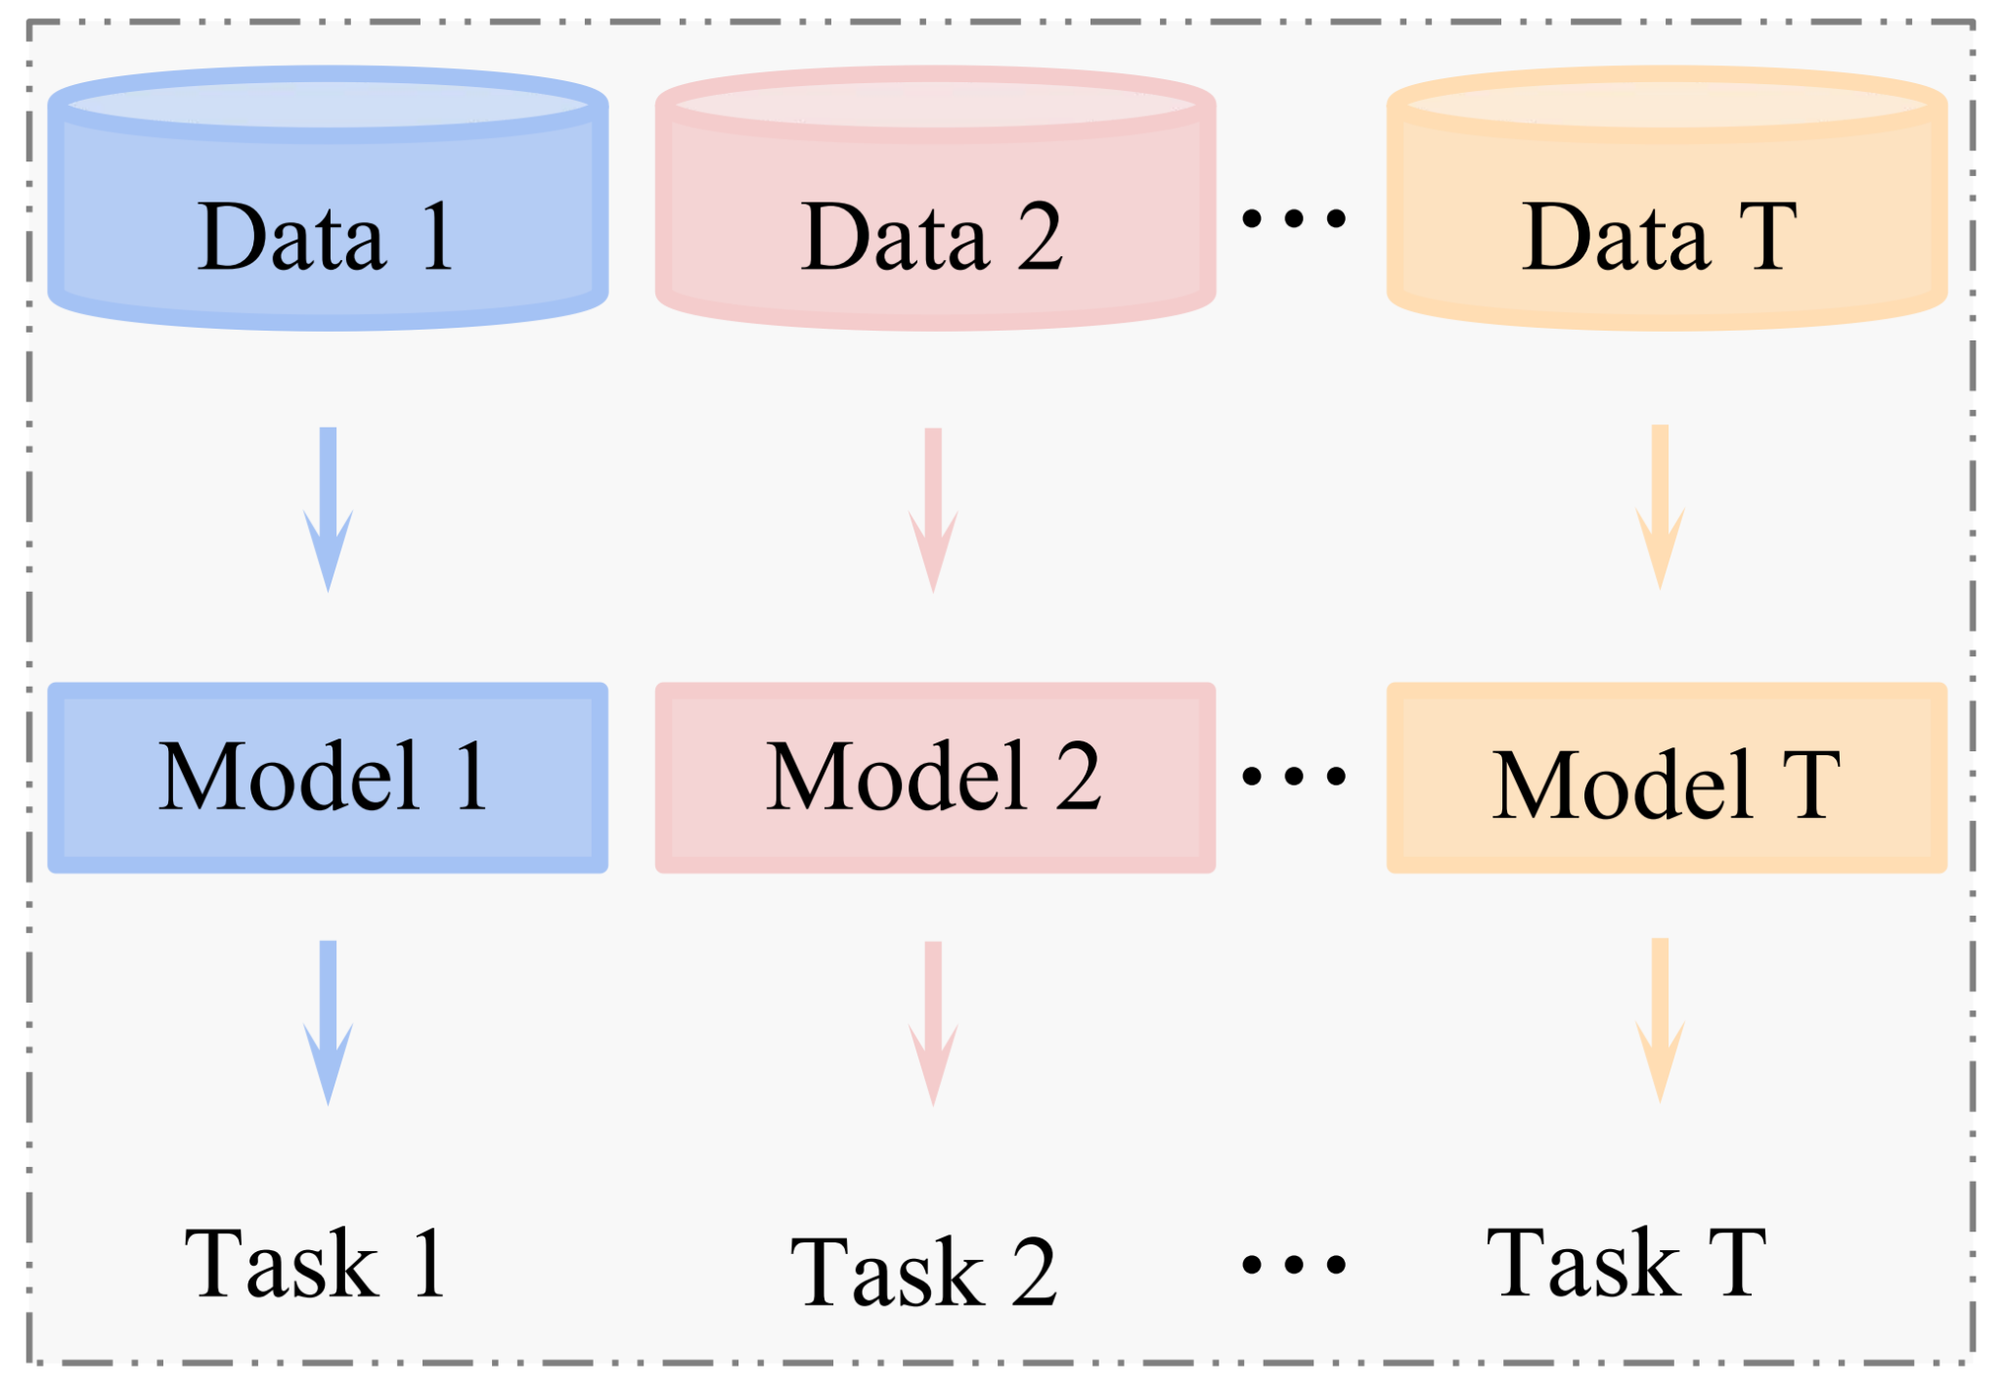
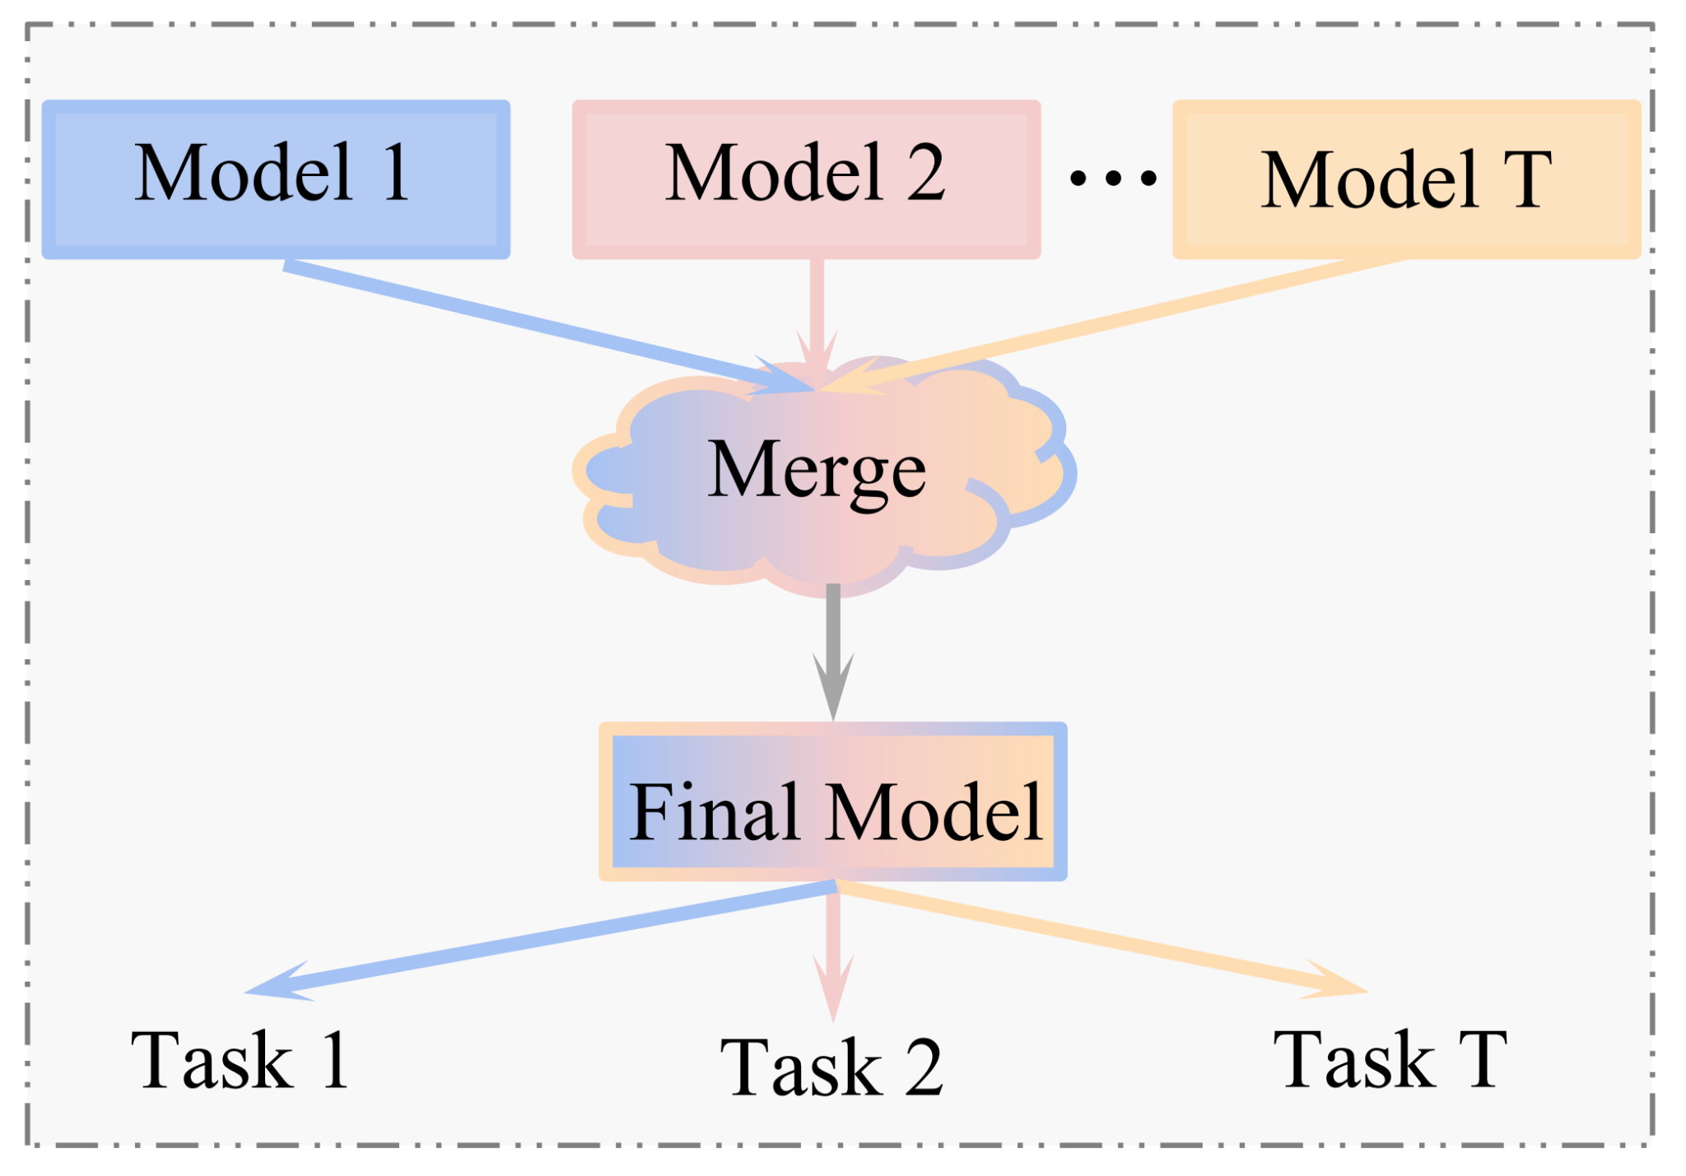
Why Model Merging
Most popular pre-trained models were created by large corporations, without involvement from most of the research community.
Even worse, most pre-trained models are never updated, it’s hard for them to learn new information to improve their performance.
Build pre-trained models in the same way that we build open-source software offers a solution to these challenges.
Models could be developed by a large community who continually update them.
Models could be be modularized, and easy to reuse and improve.
Separate Training
Yang, Enneng, et al. "Model merging in llms, mllms, and beyond: Methods, theories, applications and opportunities."
Model Merging

Slide 3
Why Model Merging
In distributed open-source software development, “merge conflicts” occur when contributors introduce conflicting changes to the same part of the codebase.
Model merging has the similar problem.
Therefore, research in how to merge model better become valuable.
Separate Training
Yang, Enneng, et al. "Model merging in llms, mllms, and beyond: Methods, theories, applications and opportunities."
Model Merging

Slide 4
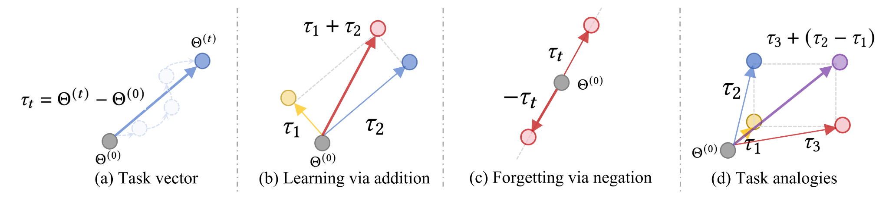
Prior Work: Basic Methods
Model Soups (Model soups: averaging weights of multiple fine-tuned models improves accuracy without increasing inference time)
Directly average the parameters of multiple models.
Wortsman, Mitchell, et al. "Model soups: averaging weights of multiple fine-tuned models improves accuracy without increasing inference time." Task Arithmetic (Editing models with task arithmetic)
Introduced the concept of Task Vector, which represents the model parameter Θ(t) fine-tuned on task t subtract the pre-trained model parameter Θ(0).
Multitask learning can be accomplished by adding task vectors, forgetting can be achieved by subtracting task vectors, and task analogies can be performed using analogous task vectors.
Ilharco, Gabriel, et al. "Editing models with task arithmetic."

Slide 5
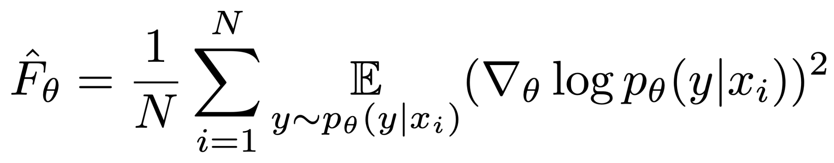
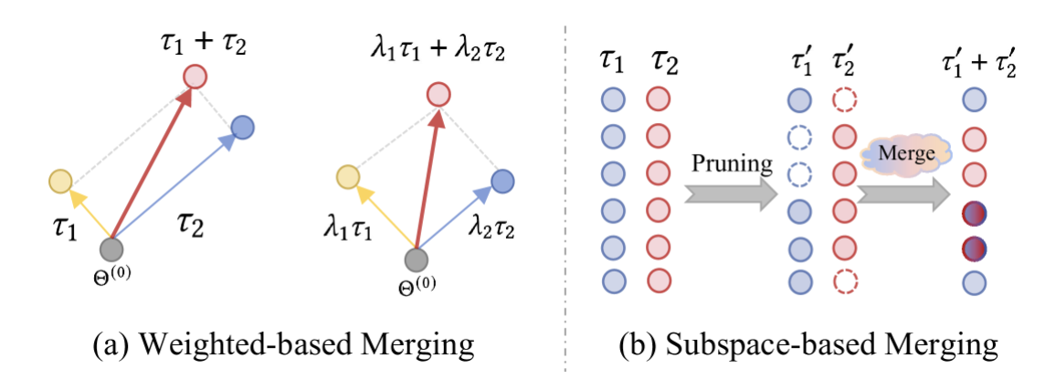
Prior Work: Weighted-based Methods
Fisher Merging (Merging Models with Fisher-Weighted Averaging)
The method performs model merging based on the parameters importance in each model.
A diagonal approximation of the Fisher Information Matrix: is used to measure the importance of each parameter for the task.
Michael, Raffel. "Merging models with fisher-weighted averaging."
Regression Mean (Dataless Knowledge Fusion by Merging Weights of Language Models)
Describe model merging as a linear regression optimization problem:
which has a closed form solution:
Jin, Xisen, et al. "Dataless knowledge fusion by merging weights of language models."
Notes:
View model merging as approximately maximizing the joint likelihood of the models’ posterior distribution over parameters. Simple parameter averaging is implicitly using an isotropic Gaussian posterior approximation.
Such anapproximation may be overly simplistic and lead to degraded performance.

Slide 6
Challenges in Prior Merging Methods
While above model parameters averaging methods has proven effective for merging.
All of these methods ignore that values may interfere across models, thereby harming the performance of the merged model. The paper demonstrates that interference can stem from two major causes:
1. Interference from redundant parameter. 2. Interference from sign disagreement.

Slide 7
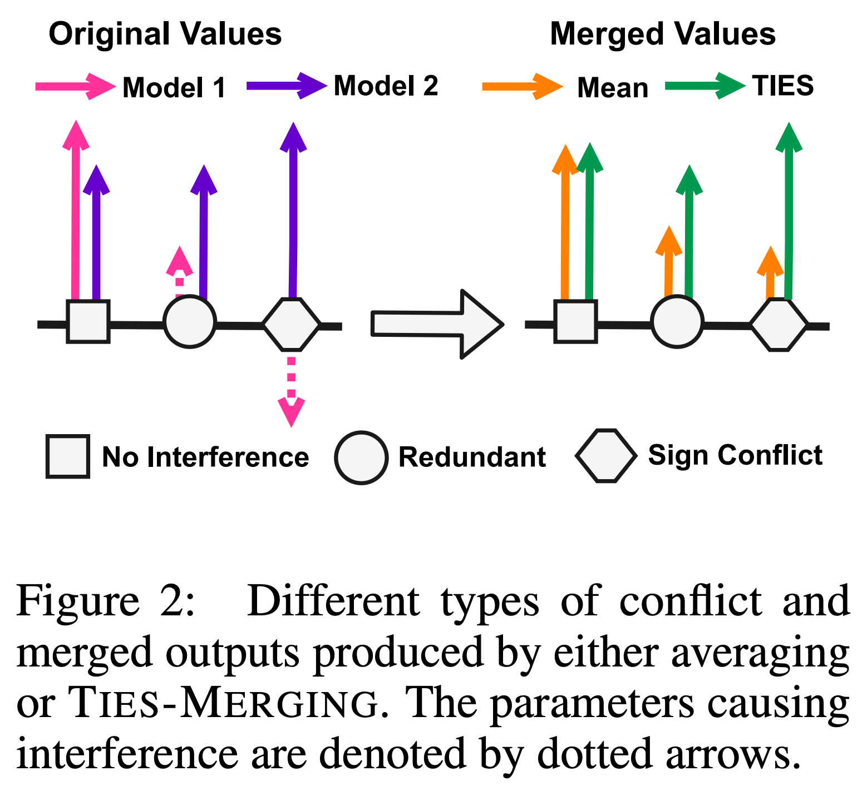
Redundant Parameter
During fine-tuning, many model parameters can change but have a small impact on performance, we call this kind of parameters “redundant”.
The influential value may be obscured by the redundant values, lowering the overall model performance.
The parameters causing interference are denoted by dotted arrows.

Slide 8
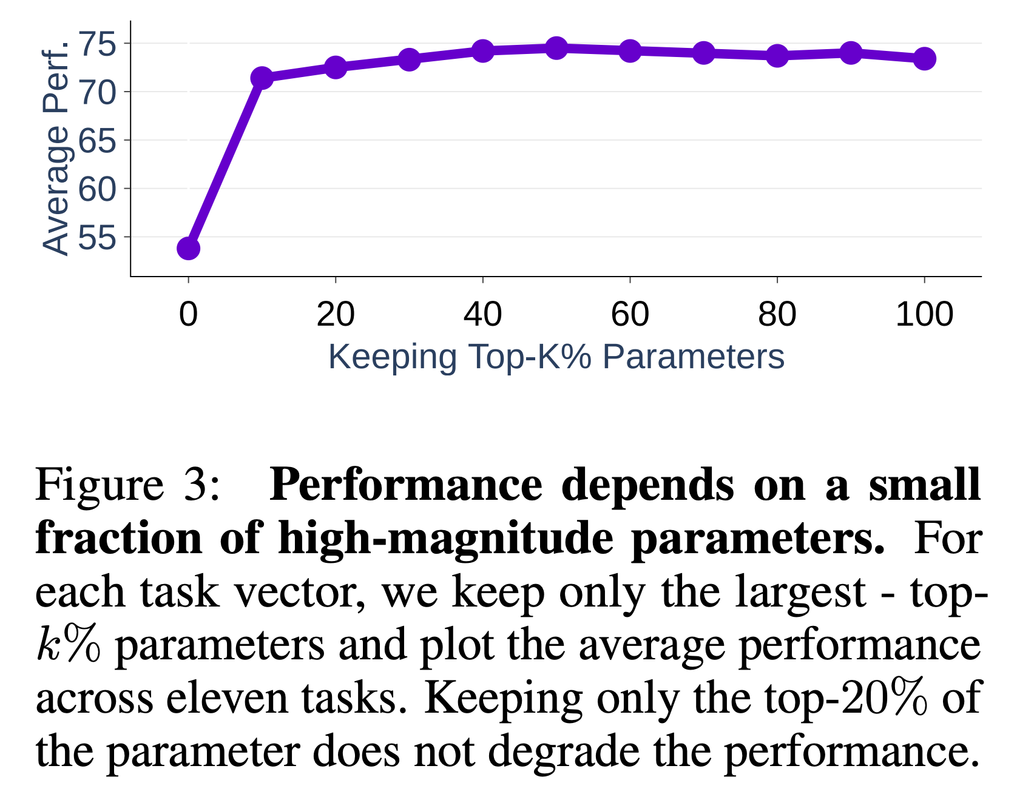
Redundant Parameter
The experiment shows that removing redundant parameters does not affect the performance of the task.
In the experiment, for each time, keep the top-k% largest-magnitude parameters and resetting the rest to their initial value.
Keeping only the top-20% parameters delivers comparable results to keeping all parameters.

Slide 9
Sign Disagreement
A given parameter might have a positive value for some models and a negative value for others. Employing simple average might compromise the performance on both tasks.

Slide 10
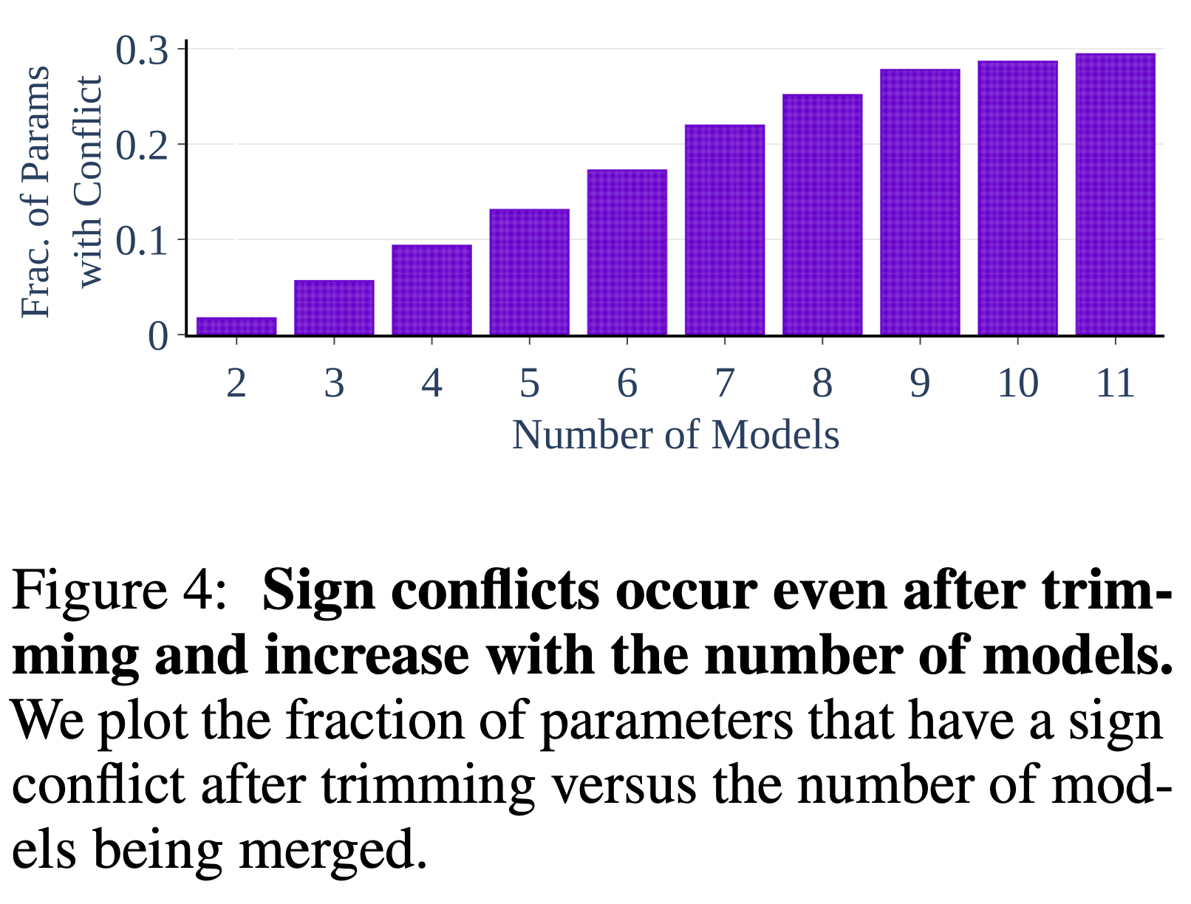
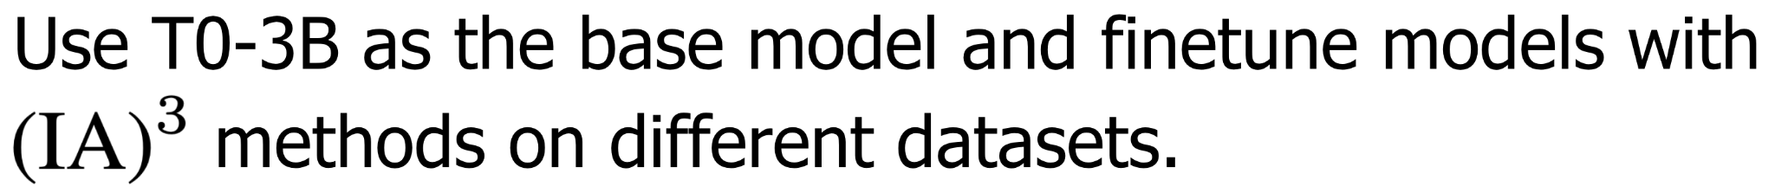
Sign Disagreement
The experiment shows that the likelihood of sign disagreement increases with the number of models being merged. Sign disagreement occur even when merging only 2 models from different tasks.

Slide 11
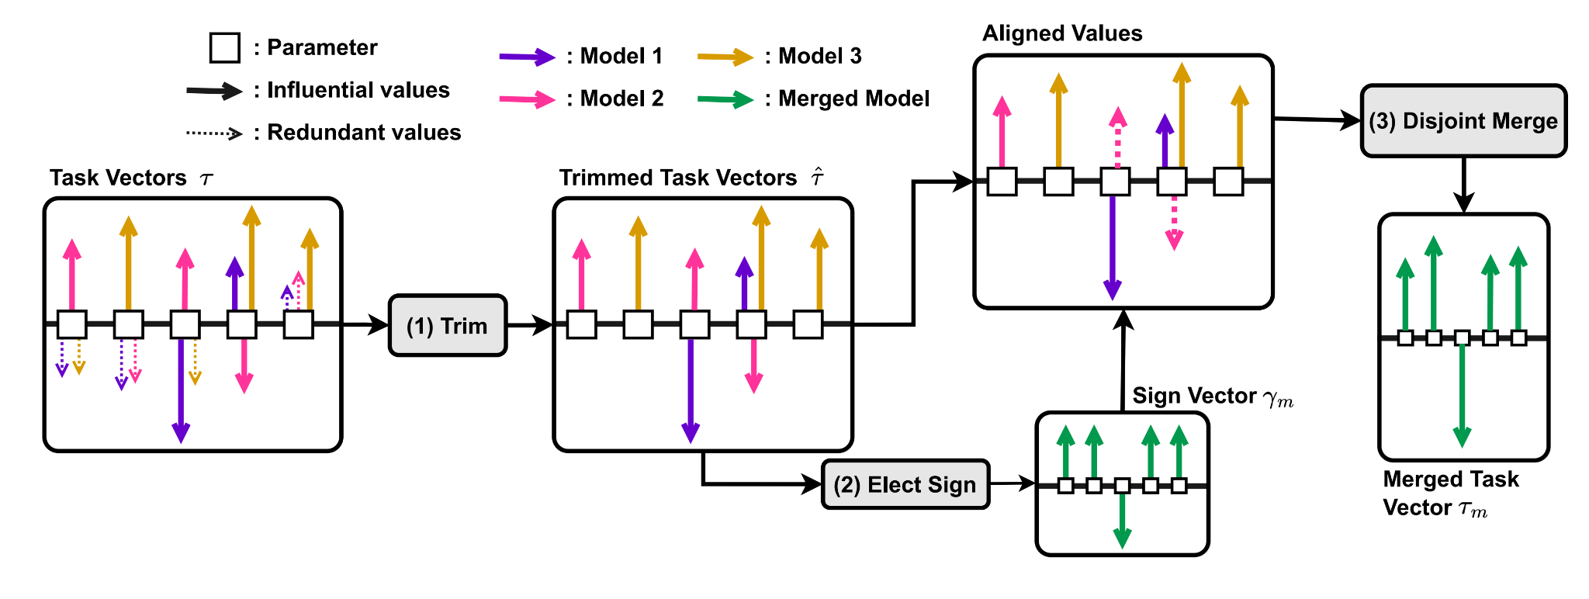
TIES-MERGING
To address the interference issue, paper propose TRIM, ELECT SIGN & MERGE (TIES-MERGING) method.

Slide 12
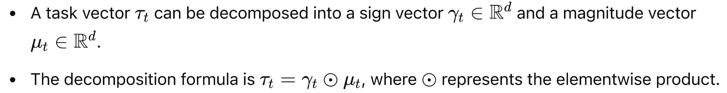
Preliminaries

Slide 13
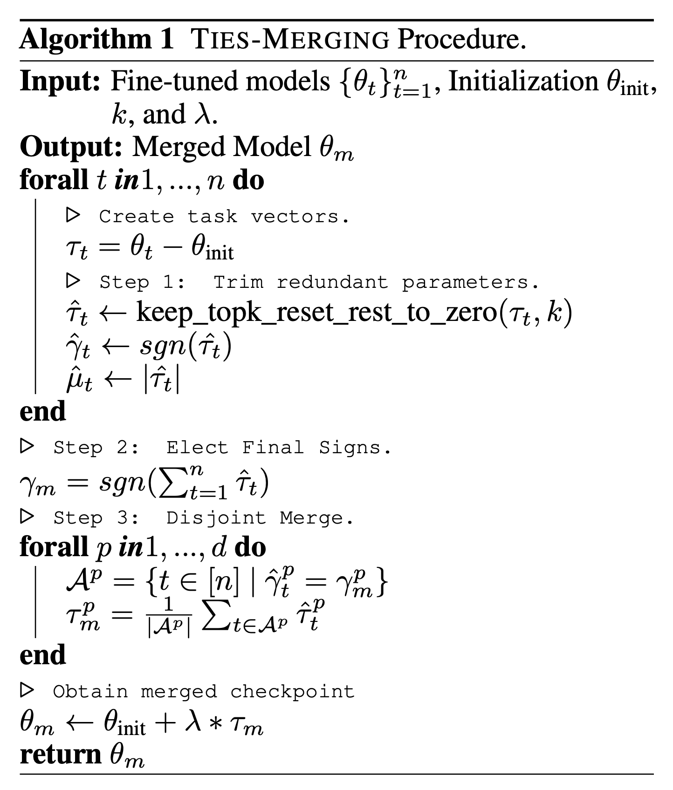
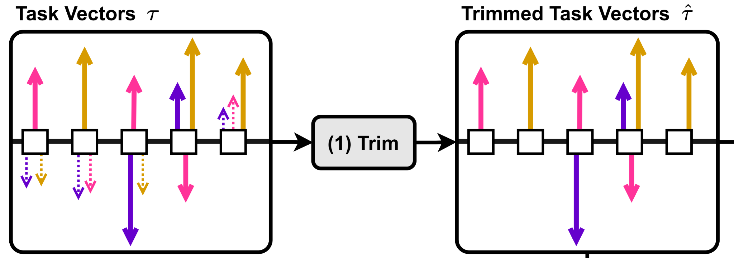
Trim
To resolve redundant parameters, for each task, the method only keep the top-k% values according to their magnitude, and setting the value of rest parameters in task vector as 0.
Before Trim: Task_Vector = [1, -2, 2, 1, 3]
Only keep top-20% Value: Task_Vector’ = [0, 0, 0, 0, 3]

Slide 14
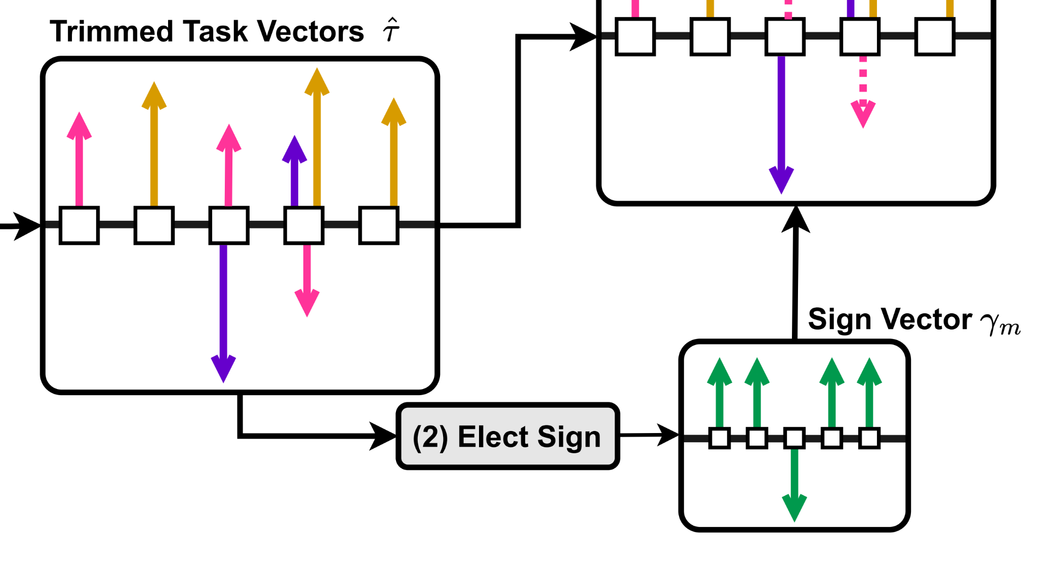
Elect
To resolve the sign disagreements, the method creates an aggregate elected sign vector.
Task_Vector_1 = [1, -2, 2, 1, 3] Task_Vector_2 = [-2, 0, 1, 0, -1]
Aggregate_Elected_Sign_Vector = [-1, -1, +1, +1, +1]

Slide 15
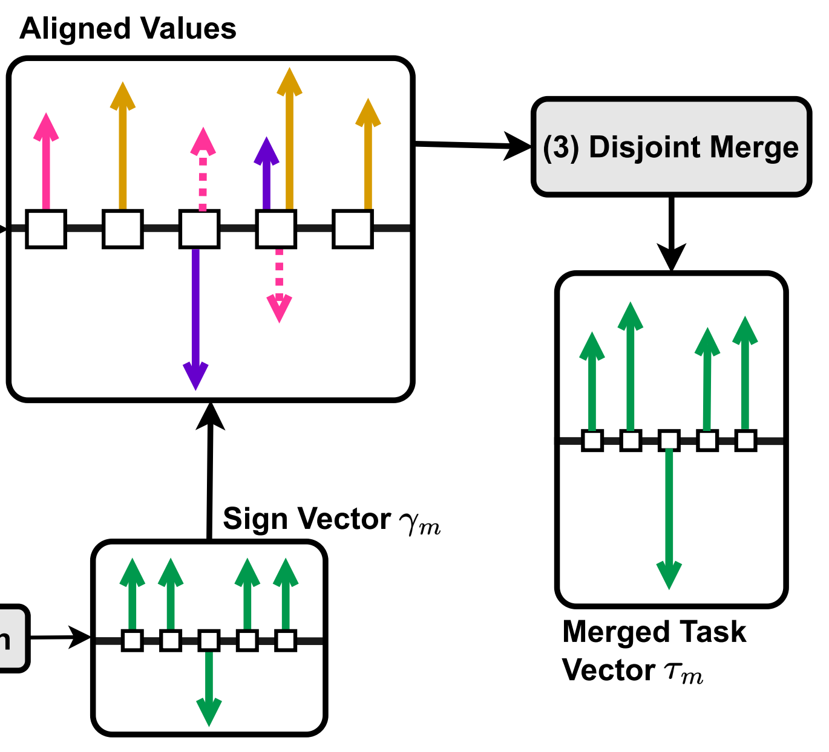
Disjoint Merge
For each parameter p, the method computes a disjoint mean, which is obtained by only keeping the parameter values whose signs are the same as the aggregated elected sign and calculate their mean.
Task_Vector_1 = [1, -2, 2, 1, 3]
Task_Vector_2 = [-2, 0, 1, 0, -1]
Task_Vecotor_3 = [-1, 1, -2, 0, -1]
Aggregate_Elected_Sign_Vector =
[-1, -1, +1, +1, +1]
Disjoint_Mean = [-1.5, -2, 1.5, 1, 3]

Slide 16
Experiment Setup: Baseline
Four baseline merging methods:
Simple Averaging
Fisher Merging
RegMean
Task Arithmetic

Slide 17
Experiment Setup: With Validation Set
Our general methods:
Perform full fine-tuning on both vision models (ViT) and language models (T5)
Perform PEFT fine-tuning on T0-3B
Finetune models on the train split of datasets and merged datasets
Keep the top-20% parameters in the task vector resetting the rest to 0
For full fine-tuning, it is for all parameter in models
For PEFT such as , it is for all scaling factors
Merge them, using each of the four baseline and our own and try to tune λ.

Slide 18
Experiment Setup: Without Validation Set
How about saving all training data for each task that are the same size as the original model?(Reg Mean proposed)
Storage and transmission cost a lot!!!
Our general methods:
apply it to full fine-tuning on ViT (vision) and T5 (language) models
keep the top-20% parameters in the task vector resetting the rest to 0
sets λ = 1.
Notes:
To avoid the need for a validation set, RegMean [31] proposed storing and transmitting inner product matrices of the training data for each task that are the same size as the original model.
This can quickly become expensive for large models as the storage and transmission scale linearly with model size and the number of tasks.
We chose this recipe based on results in the parameter-efficient fine-tuning (PEFT) setting, so we only apply it to the unseen settings of full model fine-tuning on ViT (vision) and T5 (language) models.

Slide 19
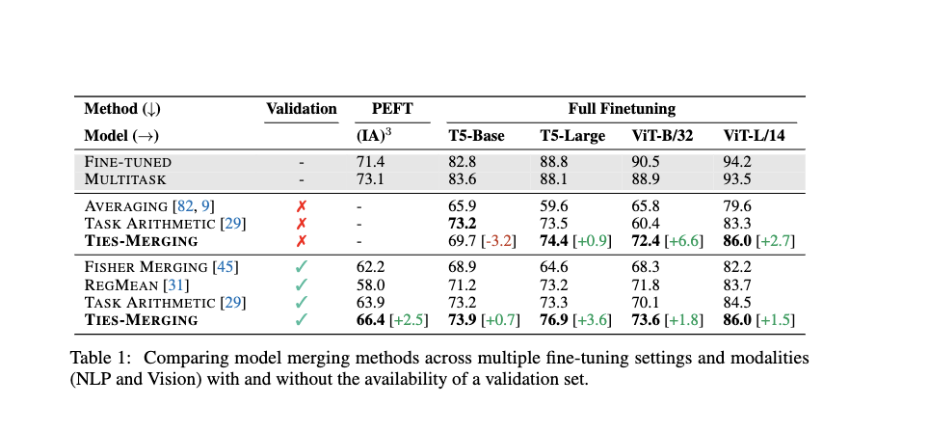
Main Results: Merging Models
λ=1
Merging PEFT Models:
Base model: T0-3B
Finetune method:
Task Datasets: 11 datasets
Merging Fully Fine-tuned NLP Models:
Base model: T5-base T5-large
Task Datasets: 7 datasets (question answering,
Paraphrase Identification…)
Merging Fully Fine-tuned Vision Models:
Base model: ViT-B/32 ViT-L/14(CLIP)
Task Datasets: 8 datasets (remote sensing, traffic classification, and satellite imagery recognition)
Notes:
Comparison:
Fine-tuned(no merge) vs multitask(no merge & combine datasets)
Large model vs small model
Different merging methods vs multitask vs fine-tuned
No validation vs using validation

Slide 20
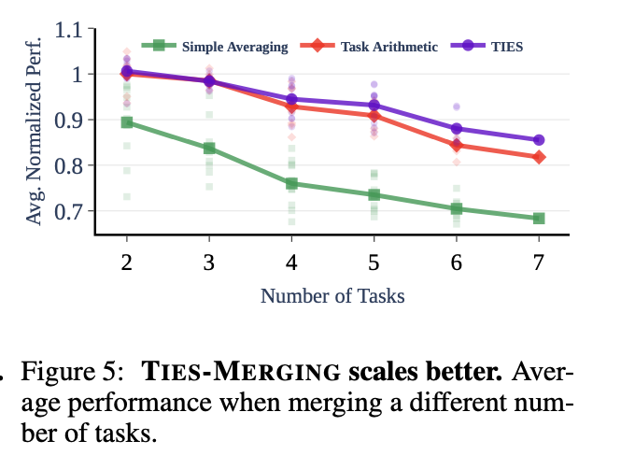
Merging Different Number of Tasks
(1) As the number of merged tasks increases, the performance of all methods decreases.
(2) Task Arithmetic and TIES-MERGING, which begin to perform better than simple averaging
(3)Task Arithmetic’s merging performance drops faster than TIES-MERGING

Slide 21
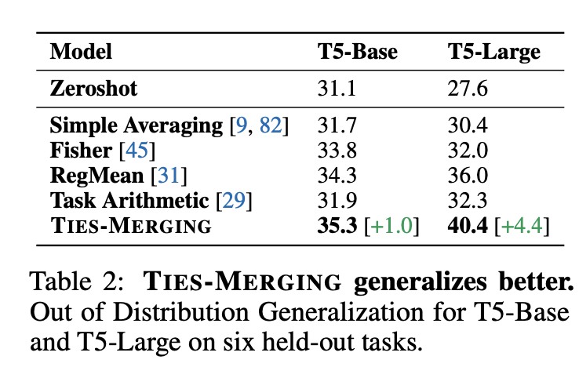
Out-of-Domain Generalization
Use the T5-base and T5-large models merged on the seven in-domain datasets from the previous experiments
Evaluate them on six held-out datasets from T0 mixture
Notes:
7 models fine-tuned on 7 in-domain datasets and merge, test on 6 held-out datasets and average the performance

Slide 22
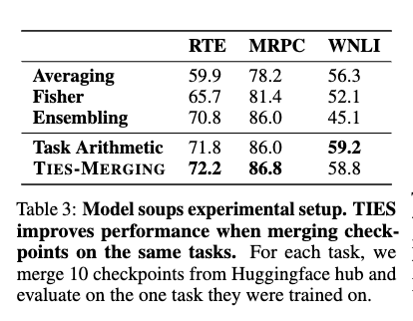
Merging Models for better Robustness
Merge multiple checkpoints trained on the same task
to see if it can improve robustness
Notes:
RTE (Recognizing Textual Entailment)
MRPC (Microsoft Research Paraphrase Corpus)
WNLI (Winograd Natural Language Inference)

Slide 23
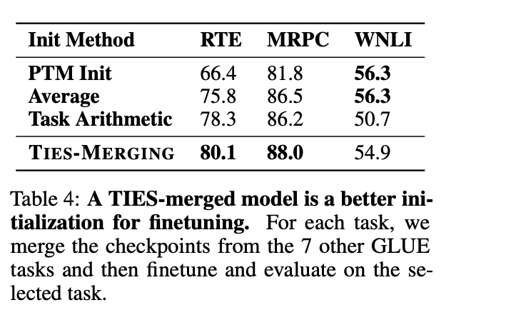
Merging Models for Better Initialization
Merge checkpoints from different tasks for a better initialization when fine-tuning on a downstream task
Fine-tuned bert-base-uncased checkpoints for 8 GLUE
tasks (wnli, sst2, rte, qnli, mrpc, cola, mnli, qqp)
Merge 7 expert models’ checkpoints
Notes:
Consider 3 downstream tasks (RTE, MRPC, WNLI)
Fine-tuned on on one task with a model merging other 7 expert models’ checkpoint

Slide 24
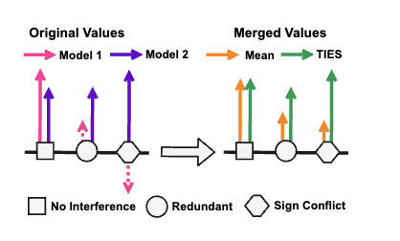
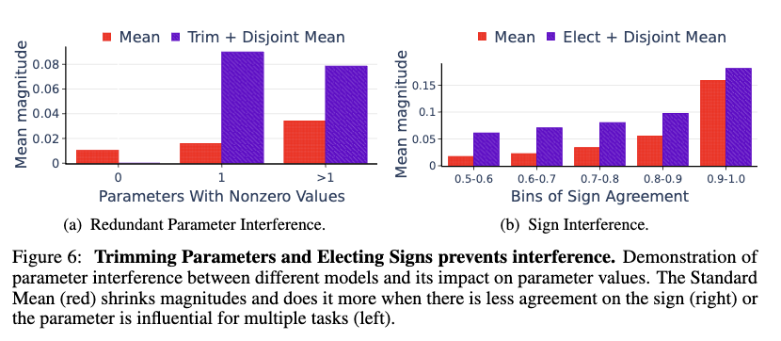
Additional Results
noise
Importance of Removing Redundant Parameters and Resolving Sign Interference
Importance of Resolving Sign Interference.
Notes:
0: redundant parameters (using a trimming threshold of 20%) - the mean value is low, and therefore may be considered noise.
1: parameters which influence 1 model - the merged value can still be low since other models assign a small value to this parameter.
>1: parameters which influence more than 1 model - The merged value is larger when more models see the parameter as influential.
0.5 indicates an equal number of positive and negative signs for a given parameter across different models
1 implies all the parameters have the same sign.
resolving signs increases the overall parameter magnitudes across different ranges of sign agreements. Parameters
with low agreement tend to be smaller on average regardless of the interference.

Slide 25
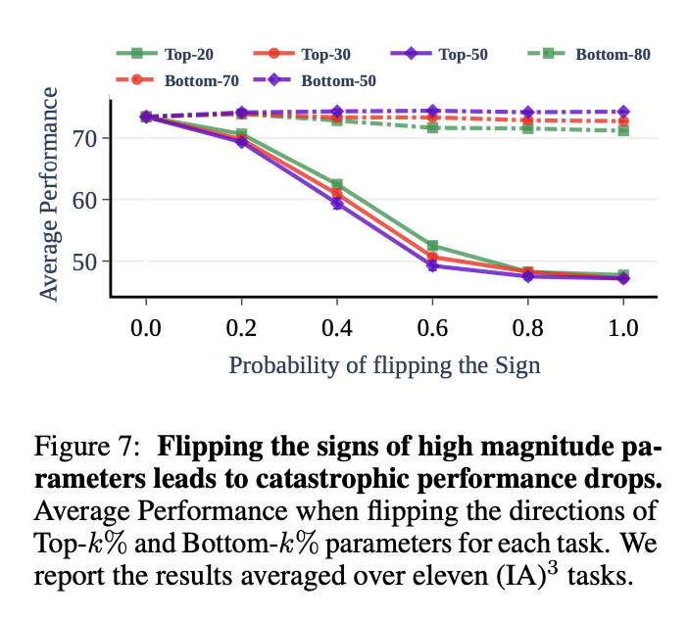
Signs of the Top-k% Parameters
dramatically decrease
Use to quantify,
Flip the direction of each of the top-k% parameters (by magnitude) with a probability p by multiplying the parameters with −1
No flips
Notes:
As a baseline, we also flip the directions of the bottom (100 − k)% of the parameters.

Slide 26
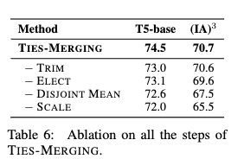
Ablation of Components
Removing elect: taking the mean of values with signs +1 and −1 but not including the 0 values of the trimmed task vectors in the mean
Removing disjoint mean: taking the mean of the values with the elected signs and the 0 for the trimmed values.
Removing scaling: using λ = 1.

Slide 27
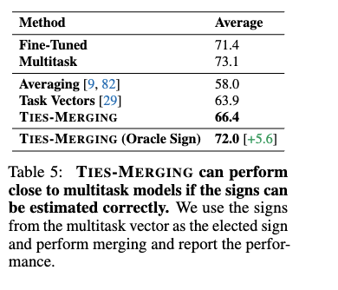
Estimating Correct Signs
Train a multitask model
Create the multitask vector , the multitask sign vector
Directly set
Closer

Slide 28
Conclusion
(1) The paper Introduce TIES-MERGING considering redundant parameters and sign disagreement, which improves multi-task merging model performance
(2) Merging individual-task models to create a multitask still lags behind the simultaneous multitask training. The performance may still improve if weight disentanglement is considered.
(3) This method can only merge models with the same base model; merging models with different base models may be more challenging.

Slide 29
THANK YOU ! ! !

Slide 30
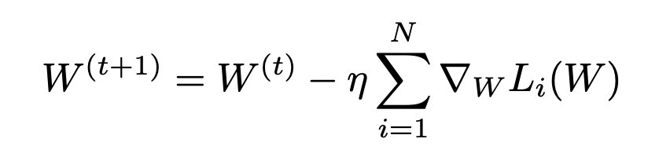
Appendix
How to Rank Parameter Magnitude in Reality?
The gradient of the loss function L(W) with respect to the parameters W points in the direction of the greatest change in the loss function. It applied in sparse fine-tuning.
1. Accumulate the weighted gradient norm across steps
2. Select the top k% of parameters with the greatest amount of variation. These parameters are the most important parameters in the task.

Slide 31
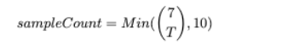
Appendix
Sample Combinations for Tasks: Optimized λ in T5 model
(2 tasks) TIES → [1.7, 1.9, 2, 2, 1.1, 1.5, 1.6, 1.8, 1.9, 1., 5]
(2 tasks) Task Arithmetic → [1, 0.9, 1, 1, 0.9, 1, 0.9, 0.9, 0.9, 1]
(3 tasks) TIES → [1.2, 2, 1.5, 1.9, 1.8, 1.7, 1.4, 2, 3, 1.9]
(3 tasks) Task Arithmetic → [1, 0.7, 0.7, 1, 1, 0.9, 0.7, 0.7, 0.9, 1]
(4 tasks) TIES → [1.5, 1.3, 1.3, 1.8, 2.3, 1.7, 1.8, 1.7, 1.9, 1.5]
(4 tasks) Task Arithmetic → [0.8, 0.7, 0.7, 0.7, 0.6, 0.7, 0.7, 0.8, 0.6, 0.7]
(5 tasks) TIES → [2, 2, 2, 1.8, 1.7, 2, 1.6, 2.1, 1.6, 1.3]
(5 tasks)Task Arithmetic → [0.7, 0.8, 0.6, 0.8, 0.7, 0.6, 0.6, 0.6, 0.6, 0.7]
(6 tasks) TIES → [1.6, 1.7, 1.7, 1.2, 1.7, 1.7, 1.5]
(6 tasks) Task Arithmetic → [0.6, 0.5, 0.5, 0.5, 0.7, 0.5, 0.6]
(7 tasks) TIES → [1.7]
(7 tasks) Task Arithmetic → [0.5]

